Slide 1
OA3103: Data Analysis
Degrees of Freedom and MLR

Slide 2
Admin
Quiz Review
Lab 1400

Slide 3
References
ISLP: Chapter 3
Degrees of Freedom aka The Geometry of Statistics by Sam Levey
Playlist ID: https://www.youtube.com/playlist?list=PLmtbsGjqSdcbF261LACoVqibOFCGQT3GI

Slide 4
Recap: What Did We Learn Yesterday?

Slide 5

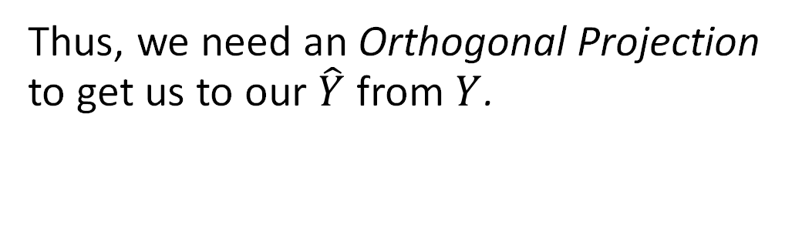



Linear Regression as a Projection
Thus, we need an Orthogonal Projection to get us to our $\hat{Y}$ from $Y$.
$$Y$$
$$\hat{Y}$$
$$1$$
$$x$$

Slide 6

The Design Matrix for SLR.
$$X≔[\begin{matrix}1 & x\end{matrix}]$$
$$X=\left[\begin{matrix}1 & x_{1} \\ 1 & x_{2} \\ ⋮ & ⋮ \\ 1 & x_{n}\end{matrix}\right]$$
for $n$ observations. What are its dimensions?

Slide 7
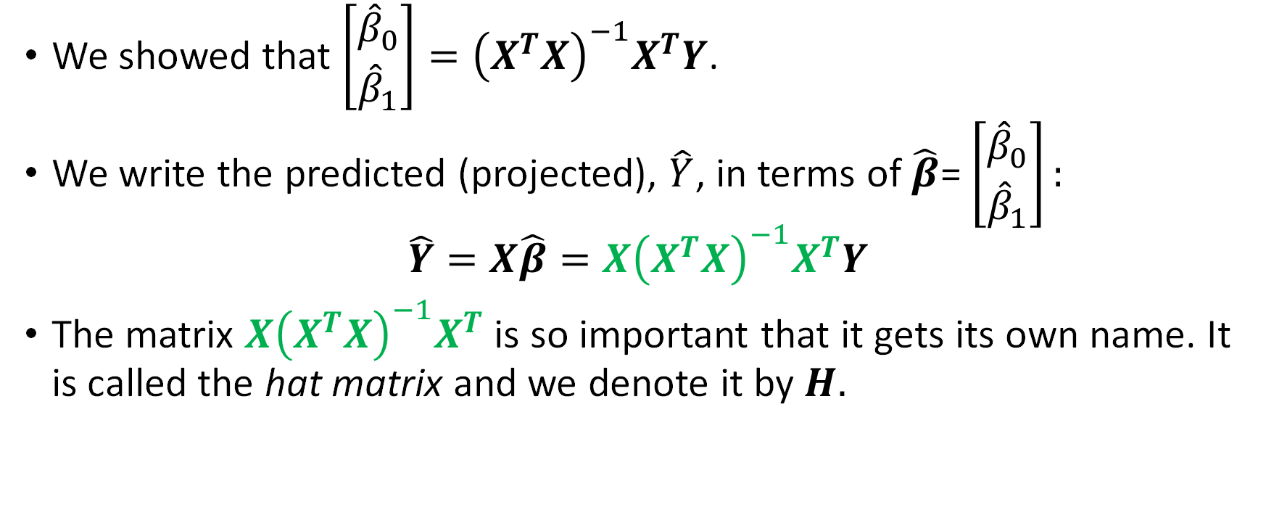
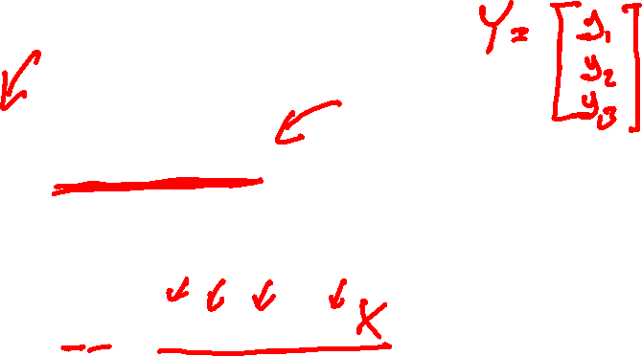
The Hat Matrix
We showed that $\left[\begin{matrix}{\hat{β}}_{0} \\ {\hat{β}}_{1}\end{matrix}\right]={\left(X^{T}X\right)}^{−1}X^{T}Y$.
We write the predicted (projected), $\hat{Y}$, in terms of $\hat{β}$= $\left[\begin{matrix}{\hat{β}}_{0} \\ {\hat{β}}_{1}\end{matrix}\right]:$
$$\hat{Y}=X\hat{β}=X{\left(X^{T}X\right)}^{−1}X^{T}Y$$
The matrix $X{\left(X^{T}X\right)}^{−1}X^{T}$ is so important that it gets its own name. It is called the hat matrix and we denote it by $H.$

Slide 8
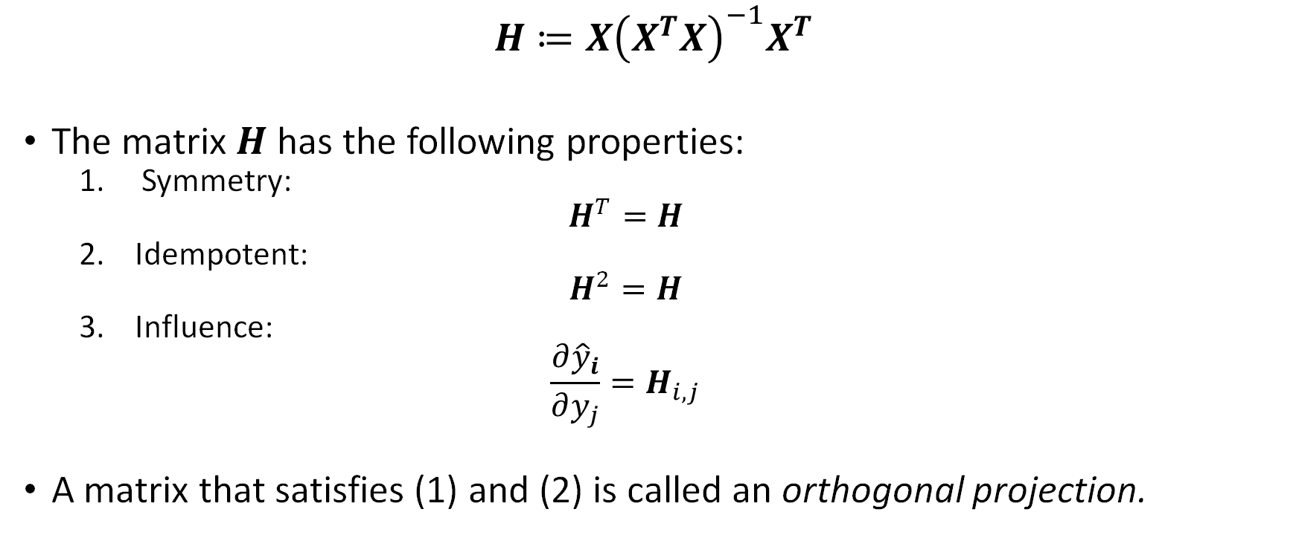
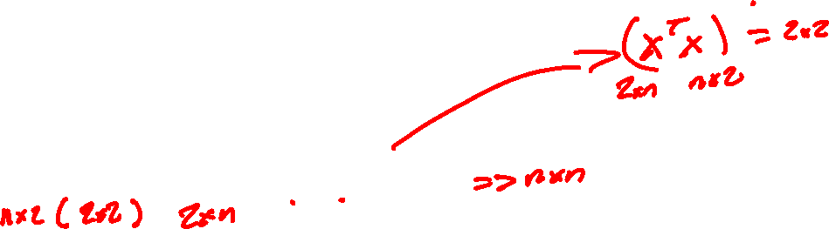
Properties of the Hat Matrix
$$H≔X{\left(X^{T}X\right)}^{−1}X^{T}$$
The matrix $H$ has the following properties:
Symmetry:
$$H^{T}=H$$
Idempotent:
$$H^{2}=H$$
Influence:
$$\frac{∂{\hat{y}}_{i}}{∂y_{j}}=H_{i,j}$$
A matrix that satisfies (1) and (2) is called an orthogonal projection.

Slide 9


Properties of the Hat Matrix
A matrix that satisfies (1) and (2) is called an orthogonal projection.
Thus, $\hat{Y}=HY$ is the orthogonal projection of $Y$onto $\hat{Y},$ which lies on the $1,x$ plane.
$$Y$$
$$1$$
$$x$$
$$\hat{Y}$$

Slide 10


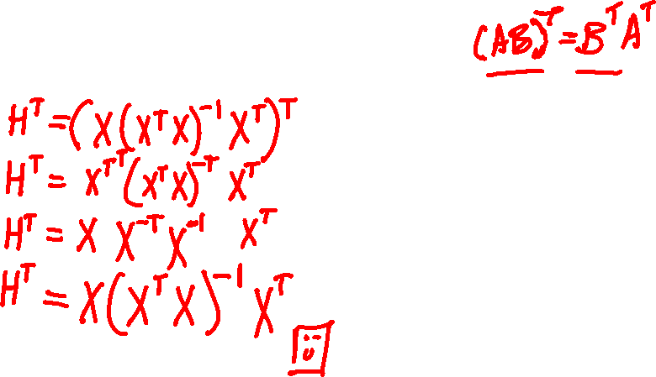
Let’s Show that $H$ is Symmetric: $H^{T}=H$
$$H≔X{\left(X^{T}X\right)}^{−1}X^{T}$$

Slide 11

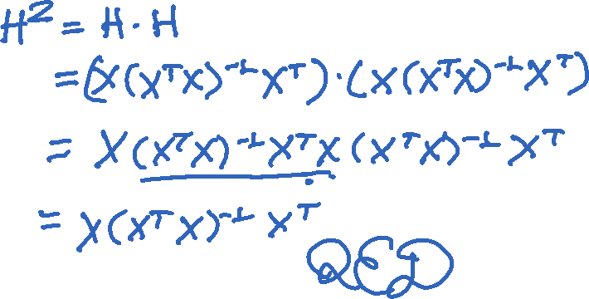
Let’s Show that $H$ is Idempotent: $H^{2}=H$
$$H≔X{\left(X^{T}X\right)}^{−1}X^{T}$$

Slide 12

Why Do We Care About Idempotence?
It guarantees that $\hat{Y}$ is the projection that was optimal.
$$H\hat{Y}=$$

Slide 13
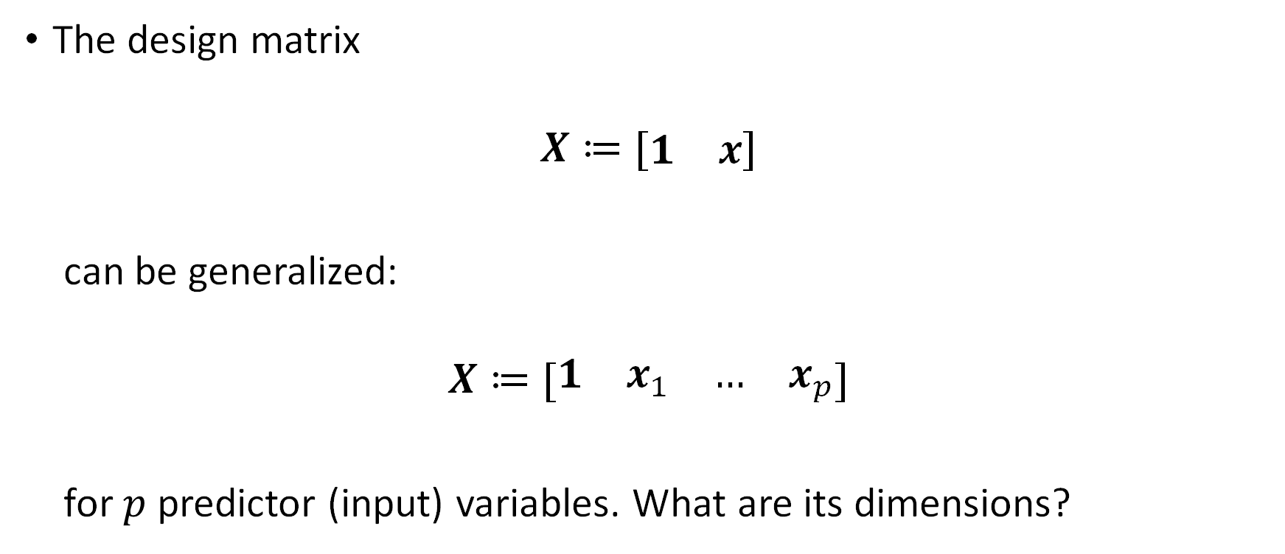

The Design Matrix in MLR
The design matrix
$$X≔[\begin{matrix}1 & x\end{matrix}]$$
can be generalized:
$$X≔[\begin{matrix}1 & x_{1} & … & x_{p}\end{matrix}]$$
for $p$ predictor (input) variables. What are its dimensions?

Slide 14

The Design Matrix
$$X≔[\begin{matrix}1 & x_{1} & … & x_{p}\end{matrix}]$$
Hence, we can solve for $p+1$ parameters:
$$\hat{β}=\left[\begin{matrix}{\hat{β}}_{0} \\ {\hat{β}}_{1} \\ ⋮ \\ {\hat{β}}_{p}\end{matrix}\right]$$

Slide 15
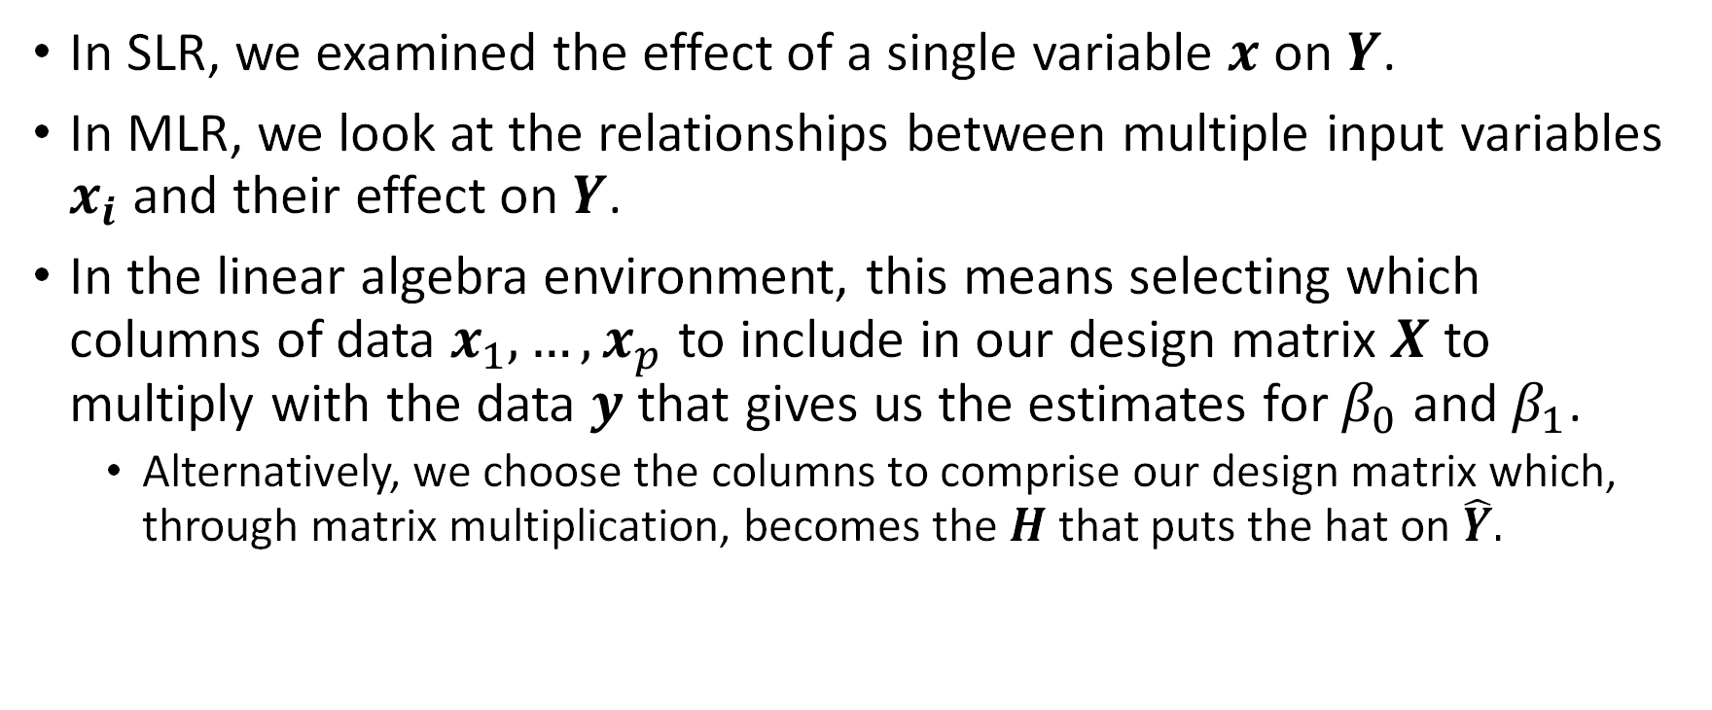
Multiple Linear Regression
In SLR, we examined the effect of a single variable $x$ on $Y$.
In MLR, we look at the relationships between multiple input variables $x_{i}$ and their effect on $Y$.
In the linear algebra environment, this means selecting which columns of data $x_{1},…,x_{p}$ to include in our design matrix $X$ to multiply with the data $y$ that gives us the estimates for $β_{0}$ and $β_{1}$.
Alternatively, we choose the columns to comprise our design matrix which, through matrix multiplication, becomes the $H$ that puts the hat on $\hat{Y}.$

Slide 17
What are Degrees of Freedom Anyways?
How have you heard this defined as?
Df =

Slide 18
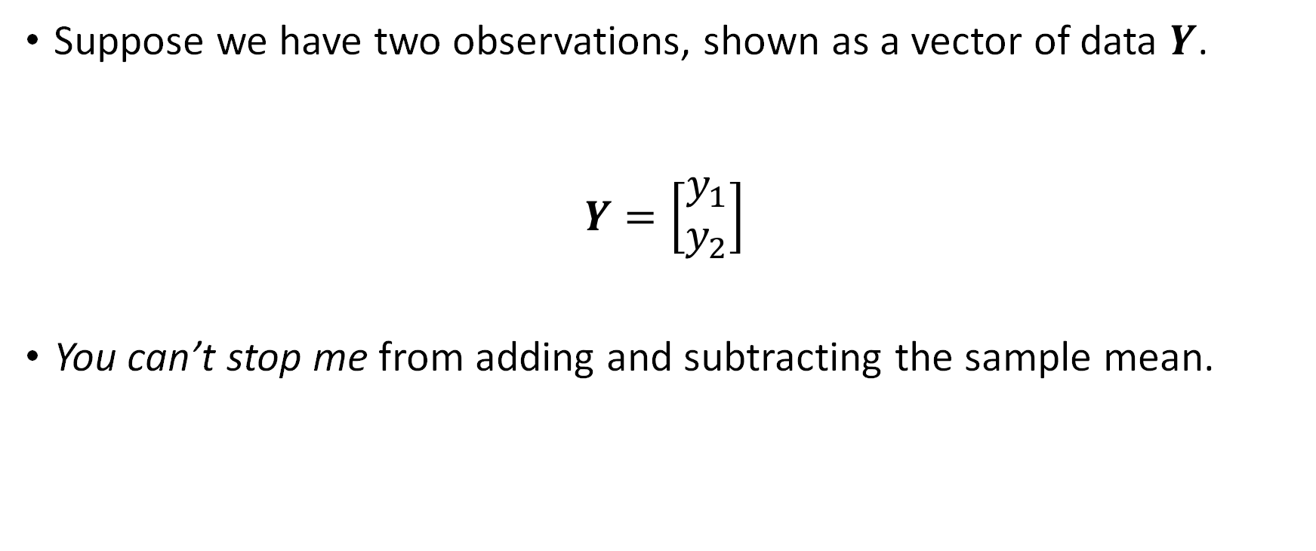
Decomposing a Data Vector
Suppose we have two observations, shown as a vector of data $Y$.
$$Y=\left[\begin{matrix}y_{1} \\ y_{2}\end{matrix}\right]$$
You can’t stop me from adding and subtracting the sample mean.

Slide 19

Decomposing a Data Vector
You can’t stop me from adding and subtracting the sample mean:
$$Y=\left[\begin{matrix}y_{1} \\ y_{2}\end{matrix}\right]=\left[\begin{matrix}y_{1}−\overline{y}+\overline{y} \\ y_{2}−\overline{y}+\overline{y}\end{matrix}\right]$$

Slide 20

Decomposing a Data Vector
And this decomposes into a residual vector and a sample mean vector.
$$Y=\left[\begin{matrix}y_{1} \\ y_{2}\end{matrix}\right]=\left[\begin{matrix}y_{1}−\overline{y} \\ y_{2}−\overline{y}\end{matrix}\right]+\left[\begin{matrix}\overline{y} \\ \overline{y}\end{matrix}\right]$$

Slide 21

Decomposing a Data Vector
Since the original sample size is 2, $Y$ itself has 2 degrees of freedom.
$$Y=\left[\begin{matrix}y_{1} \\ y_{2}\end{matrix}\right]=\left[\begin{matrix}y_{1}−\overline{y} \\ y_{2}−\overline{y}\end{matrix}\right]+\overline{y}\left[\begin{matrix}1 \\ 1\end{matrix}\right]$$

Slide 22

Decomposing a Data Vector
$Y=\left[\begin{matrix}y_{1} \\ y_{2}\end{matrix}\right]=\left[\begin{matrix}y_{1}−\overline{y} \\ y_{2}−\overline{y}\end{matrix}\right]+\overline{y}\left[\begin{matrix}1 \\ 1\end{matrix}\right]$
$$y_{2}$$
$$y_{1}$$

Slide 23

Decomposing a Data Vector
$Y=\left[\begin{matrix}y_{1} \\ y_{2}\end{matrix}\right]=\left[\begin{matrix}y_{1}−\overline{y} \\ y_{2}−\overline{y}\end{matrix}\right]+\overline{y}\left[\begin{matrix}1 \\ 1\end{matrix}\right]$
The residual variation must lie on the residual vector.
$$y_{2}$$
$$y_{1}$$

Slide 24

Decomposing a Data Vector
$$y_{3}$$
$Y=\left[\begin{matrix}y_{1} \\ y_{2} \\ y_{2}\end{matrix}\right]=\left[\begin{matrix}y_{1}−\overline{y} \\ y_{2}−\overline{y} \\ y_{3}−\overline{y}\end{matrix}\right]+\overline{y}\left[\begin{matrix}1 \\ 1 \\ 1\end{matrix}\right]$
We’ll demo this more clearly in desmos.
$$y_{2}$$
$$y_{1}$$

Slide 25

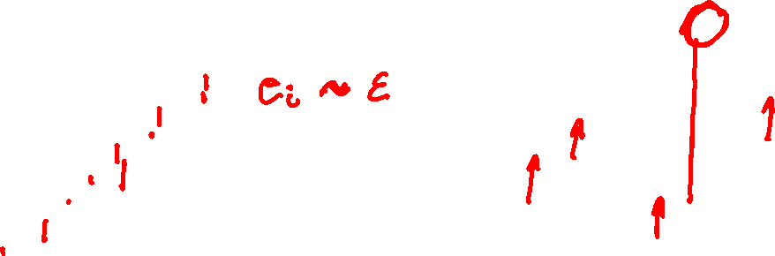

The Design Matrix $X$ and Degrees of Freedom
Regression decomposes $ℝ^{n}$ into two pieces:
The subspace spanned by the design matrix $X$, and
The subspace of the where the residuals live
(1) and (2) are orthogonal complements. Every vector in (1) is orthogonal to every vector (the residuals) in (2).

Slide 26
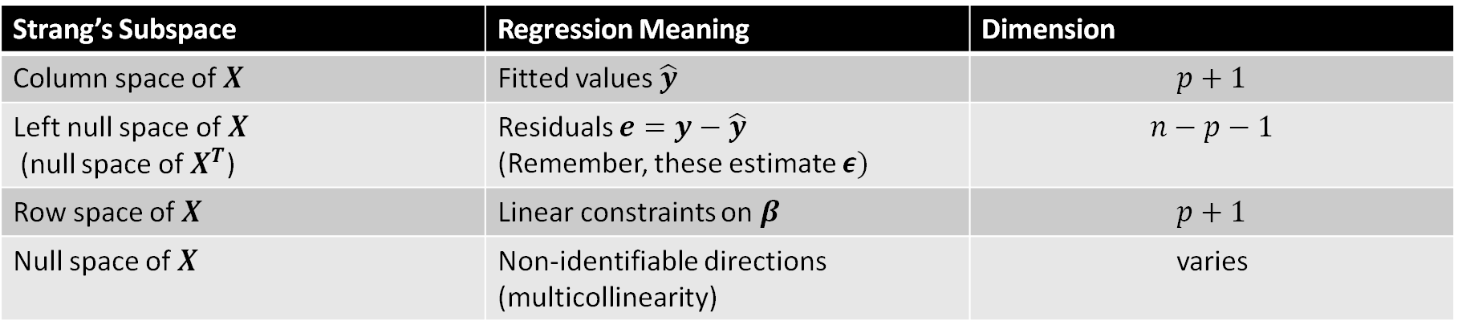

The “Big 4” Subspaces
Many linear algebraists (particularly Gilbert Strang) refer to four subspaces. We look at these for $X$:
Strang’s Subspace | Regression Meaning | Dimension
Column space of $X$ | Fitted values $\hat{y}$ | $$p+1$$
Left null space of $X$ (null space of $X^{T}$) | Residuals $e=y−\hat{y}$ (Remember, these estimate $ε)$ | $$n−p−1$$
Row space of $X$ | Linear constraints on $β$ | $$p+1$$
Null space of $X$ | Non-identifiable directions (multicollinearity) | varies
*See Linear Algebra and Its Applications by Gilbert Strang, as well as his MIT Open Courseware Videos for more.

Slide 27
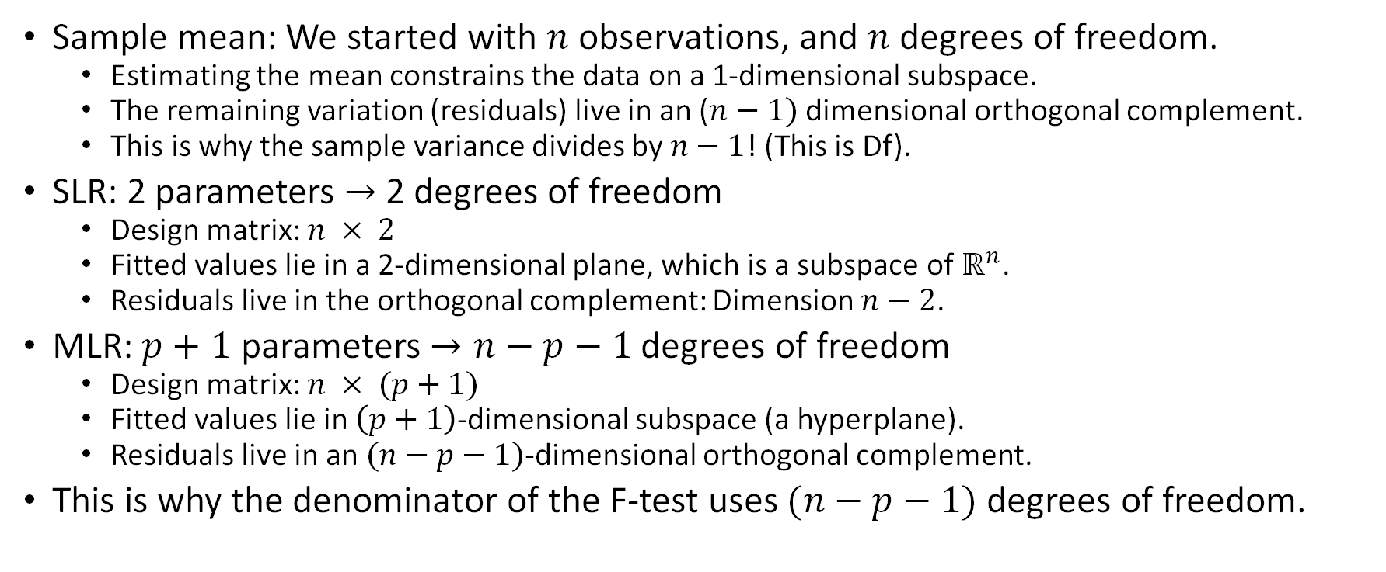
Degrees of Freedom as Leftover Dimensions
Sample mean: We started with $n$ observations, and $n$ degrees of freedom.
Estimating the mean constrains the data on a 1-dimensional subspace.
The remaining variation (residuals) live in an ($n−1)$ dimensional orthogonal complement.
This is why the sample variance divides by $n−1$! (This is Df).
SLR: 2 parameters $→$2 degrees of freedom
Design matrix: $n × 2$
Fitted values lie in a 2-dimensional plane, which is a subspace of $ℝ^{n}$.
Residuals live in the orthogonal complement: Dimension $n−2$.
MLR: $p+1$ parameters $→n−p−1$ degrees of freedom
Design matrix: $n × (p+1)$
Fitted values lie in $\left(p+1\right)$-dimensional subspace (a hyperplane).
Residuals live in an $(n−p−1)$-dimensional orthogonal complement.
This is why the denominator of the F-test uses $(n−p−1)$ degrees of freedom.

Slide 29
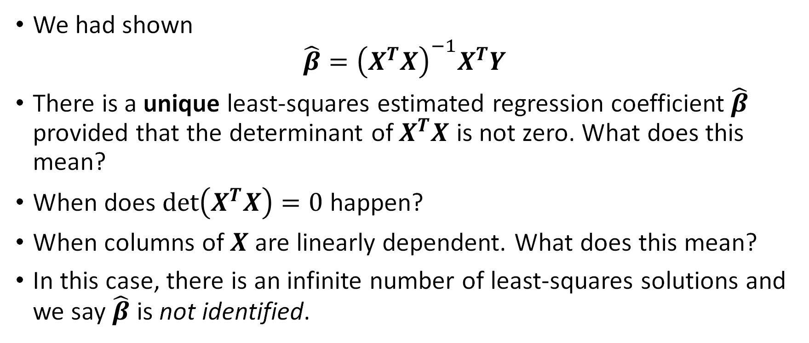
Identifiability
We had shown
$${\hat{β}=\left(X^{T}X\right)}^{−1}X^{T}Y$$
There is a unique least-squares estimated regression coefficient $\hat{β}$ provided that the determinant of $X^{T}X$ is not zero. What does this mean?
When does $\det\left(X^{T}X\right)=0$ happen?
When columns of $X$ are linearly dependent. What does this mean?
In this case, there is an infinite number of least-squares solutions and we say $\hat{β}$ is not identified.

Slide 30
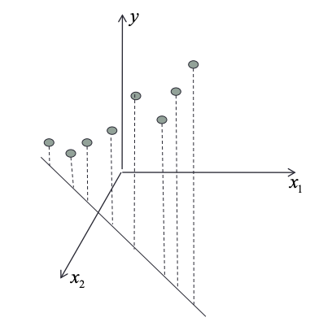

Non-Identifiability Example
Suppose we have:
$x_{1}:$ temperature measured in $℃$
$x_{2}:$ temperature measured in $℉$ $$→x_{2}=\frac{9}{5}x_{1}+32$$
$X=\left[\begin{matrix}1 & x_{1} & x_{2} \\ ⋮ & ⋮ & ⋮ \\ 1 & ⋮ & ⋮\end{matrix}\right]$??

Slide 32
Questions?

